Slide 1
ariviti.com
Sridhar Karra
Sr. VP & Chief Operating Officer
ksridhar@ariviti.com
(+91) 98451 88698
(+91) 80 4663 2433
4, Bellary Road, 12 KM, Jakkur, Bangalore
560064

Slide 2

Ariviti Technologies

Slide 3
ariviti.com
Sridhar Karra
Sr. VP & Chief Operating Officer
ksridhar@ariviti.com
(+91) 98451 88698
(+91) 80 4663 2433

Slide 4
Ariviti Technologies
4, Bellary Road, 12 KM, Jakkur, Bangalore 560064

Slide 5
Sridhar Karra
Sr. VP & Chief Operating Officer
ksridhar@ariviti.com
(+91) 98451 88698
(+91) 80 4663 2433
Ariviti Technologies
ariviti.com

Slide 6
4, Bellary Road, 12 KM, Jakkur, Bangalore 560064

Slide 7
ariviti.com
SRIDHAR KARRA.
Sr. VP & Chief Operating Officer
ksridhar@ariviti.com
(+91) 98451 88698
(+91) 80 4663 2433
4, Bellary Road, 12 KM, Jakkur, Bangalore
560064

Slide 8
ariviti.com
Sridhar Karra
Sr. VP & Chief Operating Officer
zunder.lekshmanan@ariviti.com
(+91) 98451 88698
(+91) 80 4663 2433
Ariviti Technologies

Slide 10
SRIDHAR KARRA.
Sr. VP & Chief Operating Officer
ariviti.com
ksridhar@ariviti.com
(+91) 98451 88698 (+91) 80 4663 2433
4, Bellary Road, 12 KM, Jakkur, Bangalore
560064

Slide 11
SRIDHAR
KARRA
Sr. VP & Chief Operating Officer
ariviti.com
ksridhar@ariviti.com
(+91) 98451 88698 (+91) 80 4663 2433
4, Bellary Road, 12 KM, Jakkur, Bangalore
560064

Slide 14
ARIVITI
HUMAN INTELLIGENCE . AI AMPLIFIED
RAJ KESARIMALL.
Director
ariviti.com
The AI Sherpas
raj.kesarimall@ariviti.com
(+44) 7939 645 000
(+91) 9845 009 881

Slide 15
ARIVITI
HUMAN INTELLIGENCE . AI AMPLIFIED
SARAVANA KUMAR.
Vice President – Key Accounts
ariviti.com
The AI Sherpas
saravana.kumar@ariviti.com
(+44) 7787 535 948

Slide 16
ARIVITI
HUMAN INTELLIGENCE . AI AMPLIFIED
SRIRAM JEYABHARATHI.
Chief Product & Technology Officer
ariviti.com
The AI Sherpas
sriram.jeyabharathi@ariviti.com
(+91) 961 190 9014
(+44) 7939 645 000

Slide 17



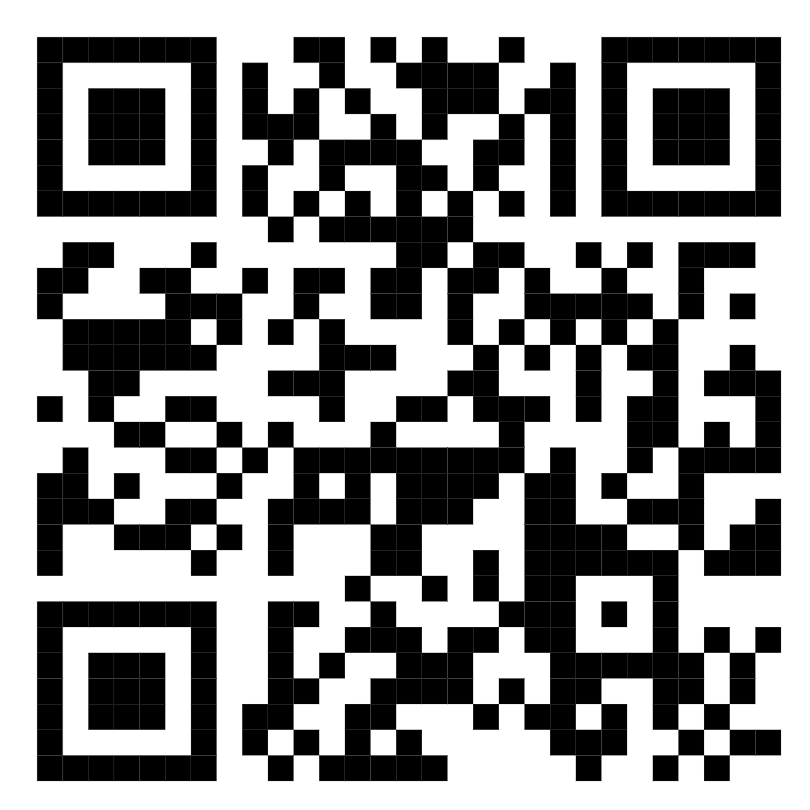
ariviti.com
The AI Sherpas
AI AMBITION.
MADE OPERATIONAL.
integramicro.com
imss.co.in
openturf.in

